Slide 1


PRESENTED BY
Shanmukha Rao Sahukari
Skill Forge – Final Presentation
Final Module Developed by: Shanmukha Rao Sahukari Tech Stack: HTML, CSS, JavaScript, MERN / Node.js , Express.js, MySQL, AI (Groq LLMs) Date: 14 December 2025

Slide 2
TABLE OF CONTENTS
Project Overview
Product Backlog (Sprint 1)
Sprint Backlog Summary
Backend Foundadtion
Backend Architecture
MYSQL Database Design
Authentication & JWT Security
Role-Based Access Control (RBAC)
Postman Testing (Milestone 2)
Postman Testing: Protected Route
Postman Testing: Register API
Postman Testing: Login API
Login Page
Register Page
Landing Page
Conclusion

Slide 3

Project Overview
What is SkillForge?
SkillForge is a full-stack e-learning platform designed to provide a seamless learning experience with course browsing, user authentication, dashboards, and future AI-powered features.
SkillForge Solves These Problems By:
✔ Authentication Module ✔ Database Setup ✔ UI’s ✔ API Development ✔ Postman Testing ✔AI-generated quizzes
✔ Automated assignment evaluation
✔ Personalized feedback
✔ Student & instructor analytics dashboards
✔ AI chatbot for instant support

Slide 4

Product Backlog (Sprint 1)
Completed Sprint Tasks
User Registration Module
User Login Module
Password Encryption (bcrypt)
JWT-based Authentication (Security)
Secure Login & Role-based Access
Student Dashboard
Instructor Dashboard
MySQL Database Setup
API Testing (Postman)(Role-based APIs)
AI Quiz Generation
AI Assignment Evaluation
Performance Analytics
AI Chatbot (Landing Page)

Slide 5

Summary
SkillForge is a role-based learning platform that enables:
Secure user authentication
Admin-controlled course management
Instructor-led course & assignment creation
Scalable backend architecture for AI features
Focus of these milestones:
Backend foundation
Security
Role-based APIs

Slide 6
Backend Architecture
Server Architecture:
Express.js REST API
MySQL database
Modular route structure
Centralized DB access using:
“ app.set("db", db) “
Middleware Used:
CORS
JSON body parser
JWT authentication middleware

Slide 7

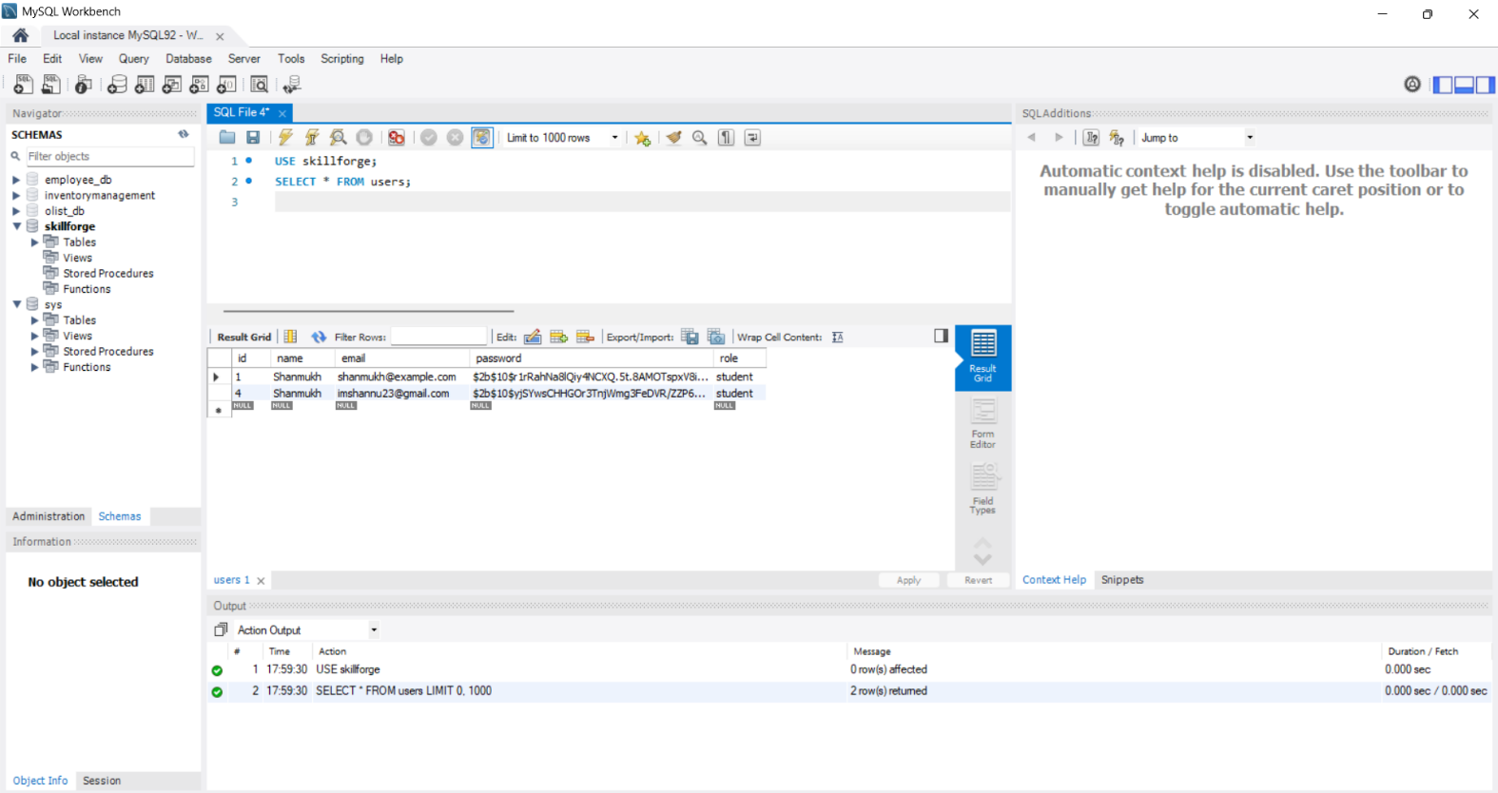
Database Design
Core Tables Created
users
id, name, email, password, role
courses
id, title, description, instructor_id, category, level, image
Key Concepts
Role stored at DB level
Foreign key relationships
Scalable for future features
Field | Type | Description
id | INT (PK, Auto Increment) | Unique user ID
name | VARCHAR | Username
email | VARCHAR (Unique) | Login email
password | VARCHAR | Hashed password

Slide 8
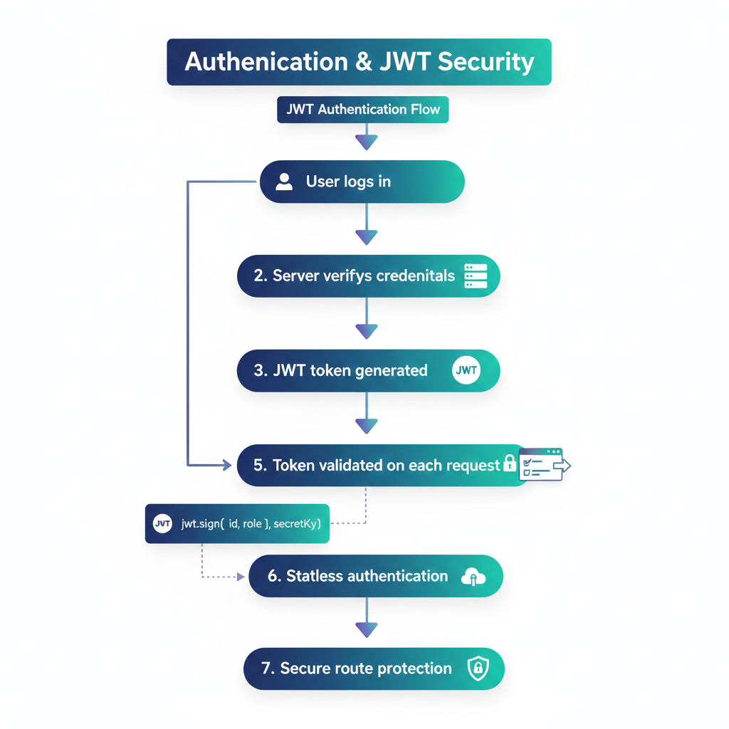
Authentication & JWT Security
JWT Authentication Flow
User logs in
Server verifies credentials
JWT token generated
Token sent to frontend
Token validated on each request
“ jwt.sign({ id, role }, secretKey) “
✔ Stateless authentication ✔ Secure route protection

Slide 9
Role-Based Access Control (RBAC)
Access Control Rules
User logs in
Admin → Full access
Instructor → Course & assignment management
Student → Limited access (future scope)
Example:
“ if (req.user.role !== "admin") return 403; “
✔ Prevents unauthorized actions ✔ Enforced on backend level

Slide 10
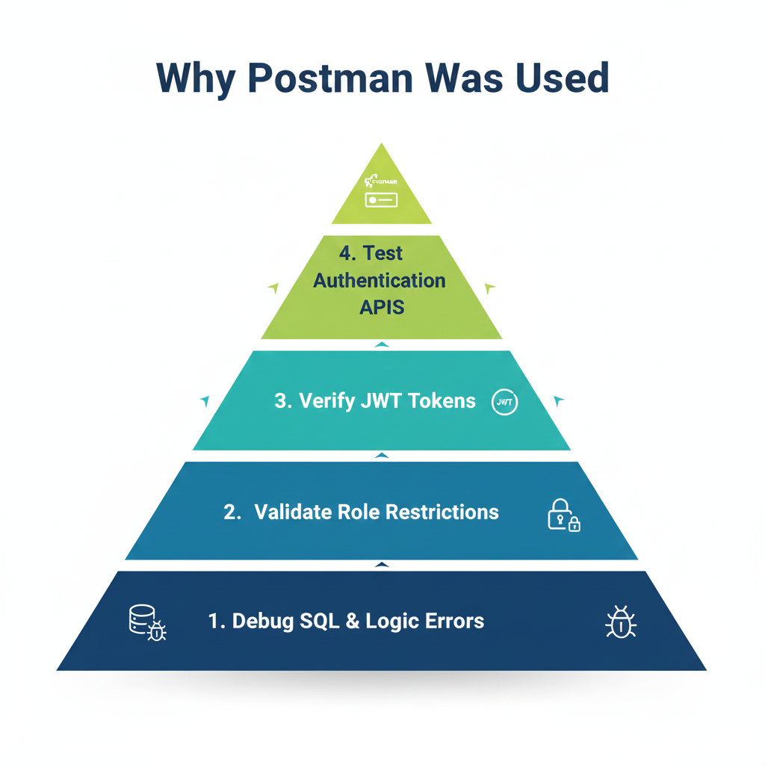
Postman Testing
Why Postman Was Used
Test authentication APIs
Verify JWT tokens
Validate role restrictions
Debug SQL & logic errors
APIs Tested:
✔ /register
✔ /login
✔ /me
📌 Postman used only for development & testing

Slide 11
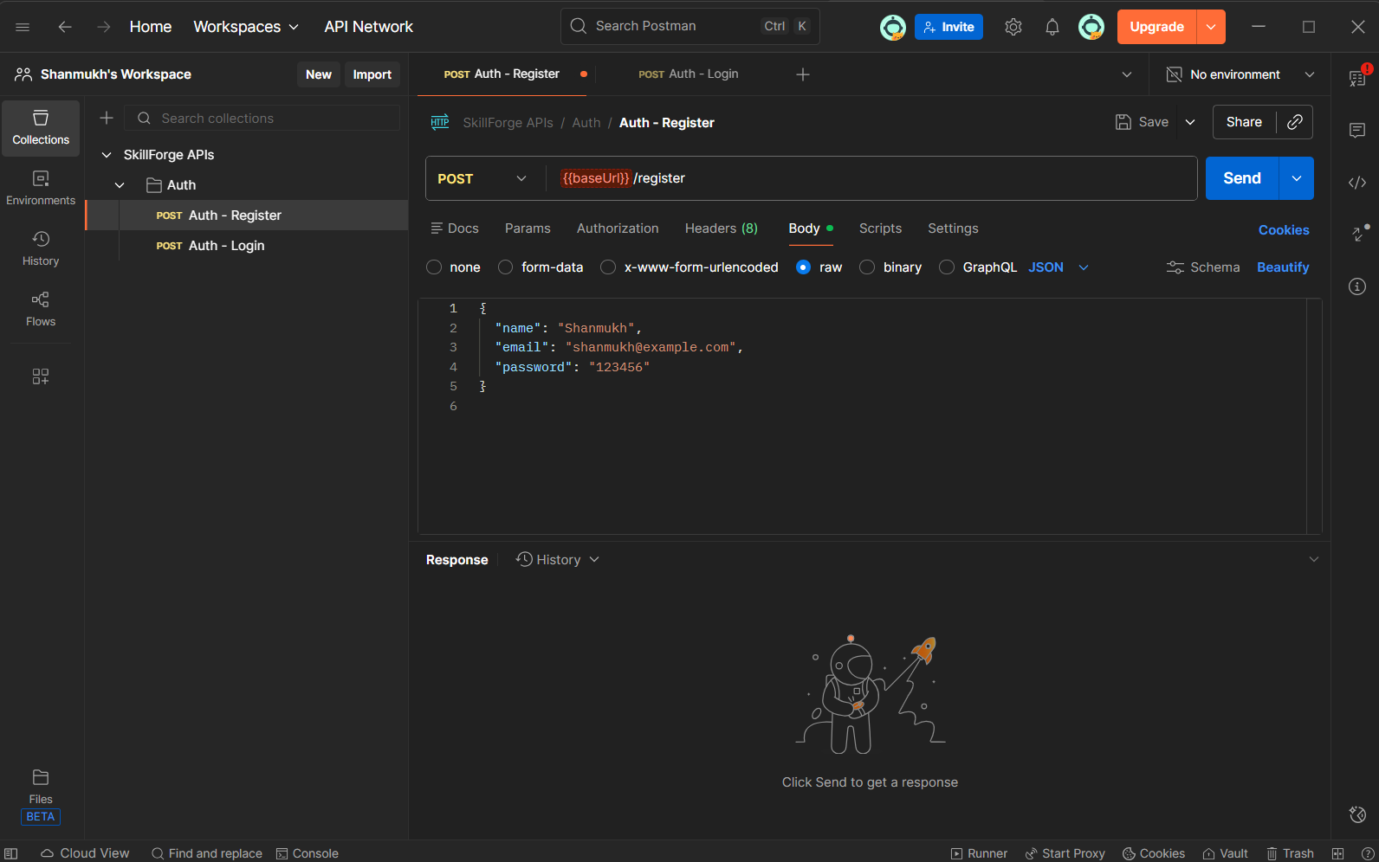
Postman Testing: Register API
Register API Test
Endpoint: POST /register
Purpose: Create new user
Tested with valid and invalid data
Stored in MySQL successfully

Slide 12
Postman Testing: Login API
Login API Test
Endpoint: POST /login
Verifies email & password
Returns JWT token + user info
Error handled: User not found, wrong password

Slide 13
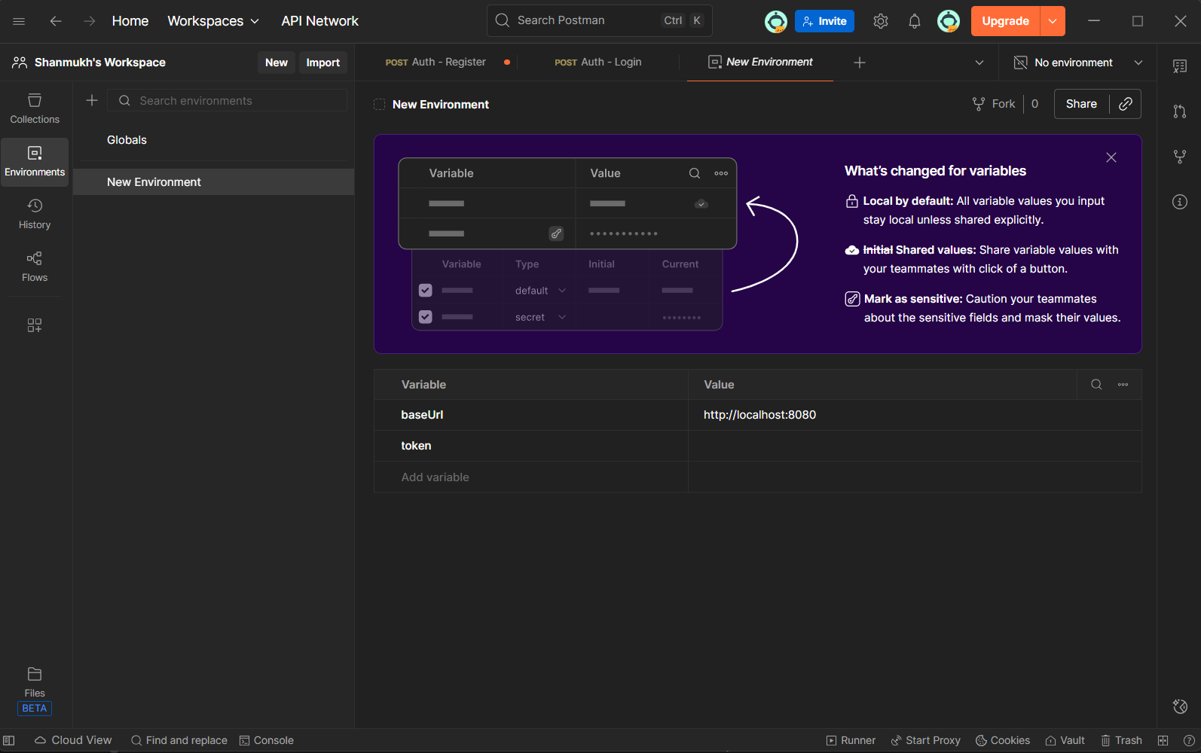
Postman Testing: Protected Route
Protected Route: /me
Requires Authorization: Bearer <token>
Returns authenticated user details
Ensures JWT security

Slide 14
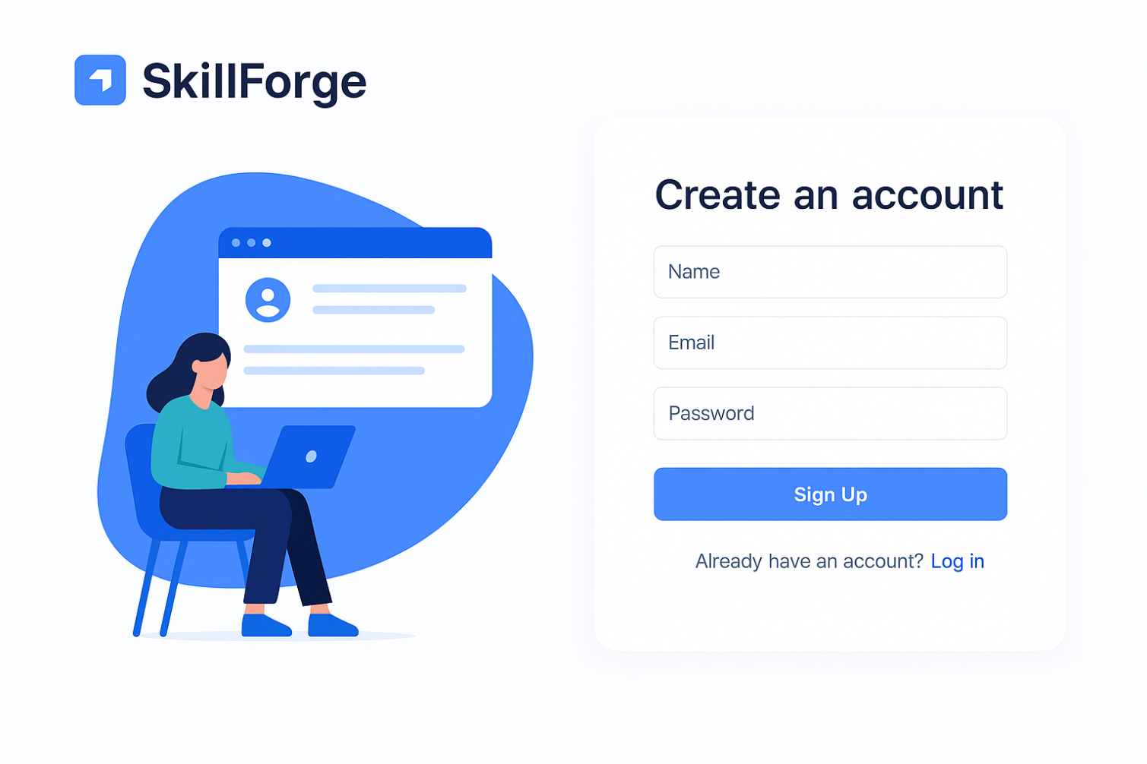
(Register Page)
Register Page Features
Name, email, password fields
Input validation
Connected to backend register API
Auto-redirect after successful signup

Slide 15
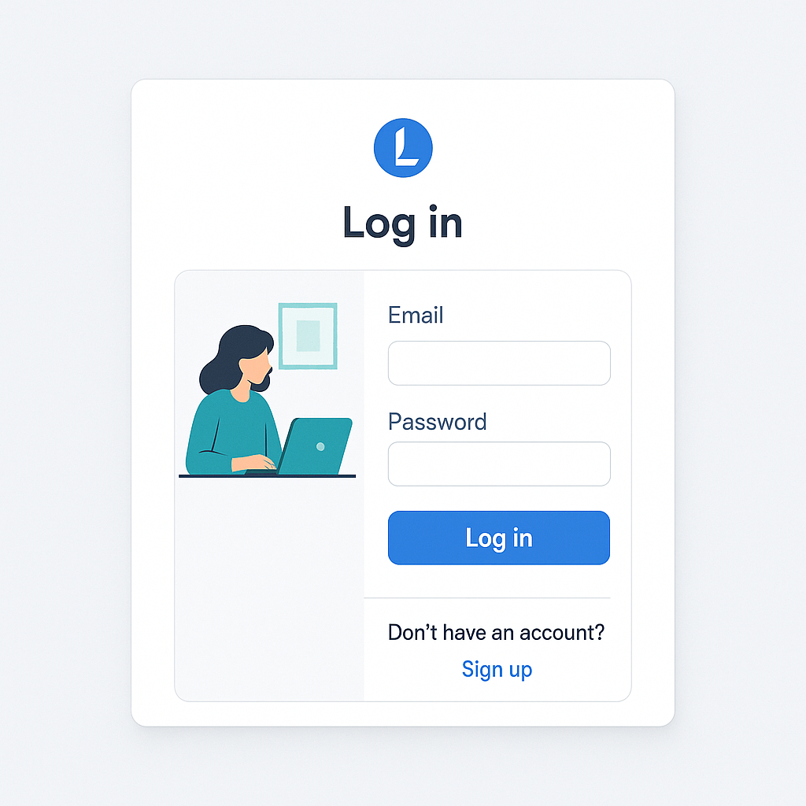
(Login Page)
Login Page Features
Clean user interface
Email and password input fields
Error handling for invalid credentials
Integrated with backend login API

Slide 16
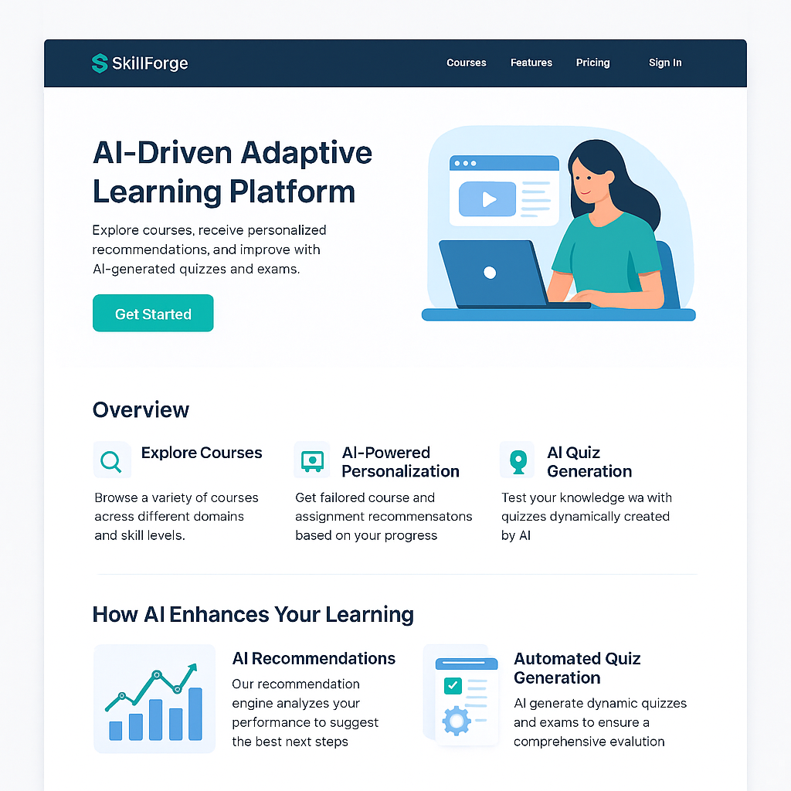
Landing Page
What the Landing Page Represents:
The landing page is the first point of interaction for users on the SkillForge learning platform. It communicates the platform’s purpose, key features, and encourages users to sign up or log in.

Slide 17
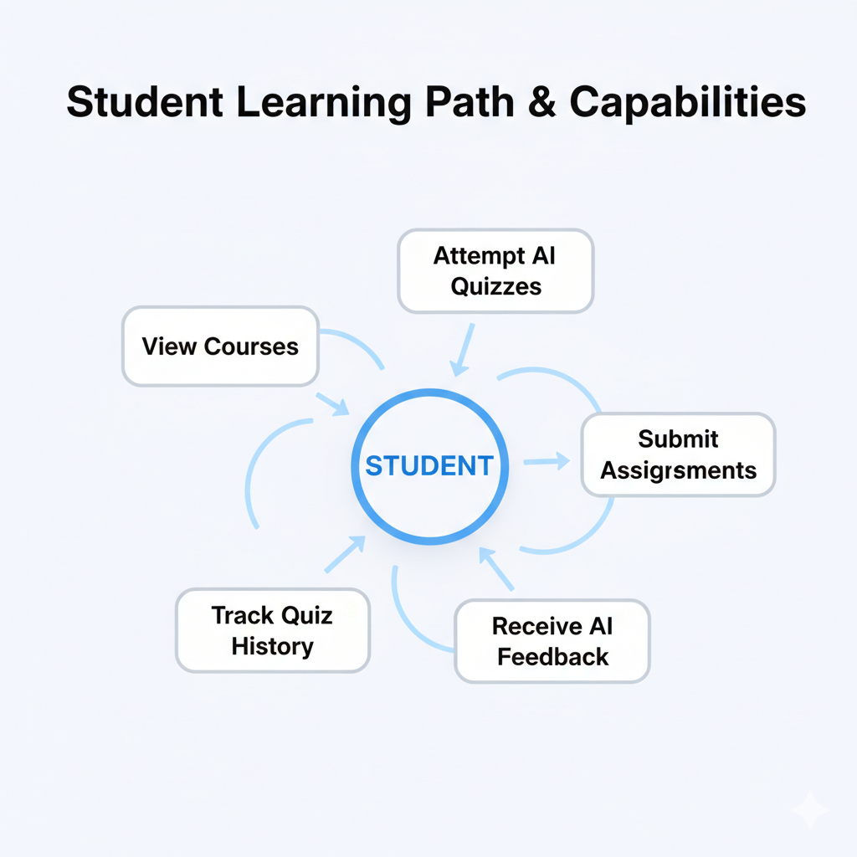
Student Dashboard
📘 Student Can:
View courses
Attempt AI quizzes
Submit assignments
Receive AI feedback
Track quiz history

Slide 18
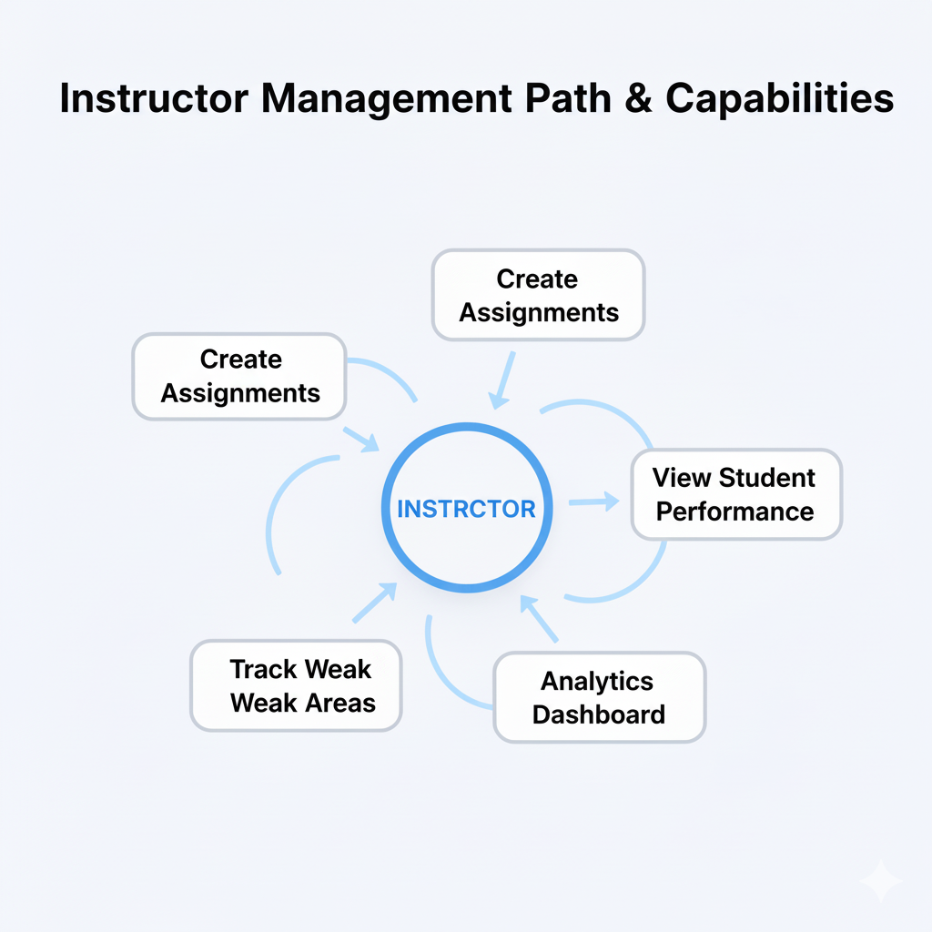
Instructor Dashboard
Instructor
Create assignments
View student performance
Analytics dashboard
Track weak areas

Slide 19
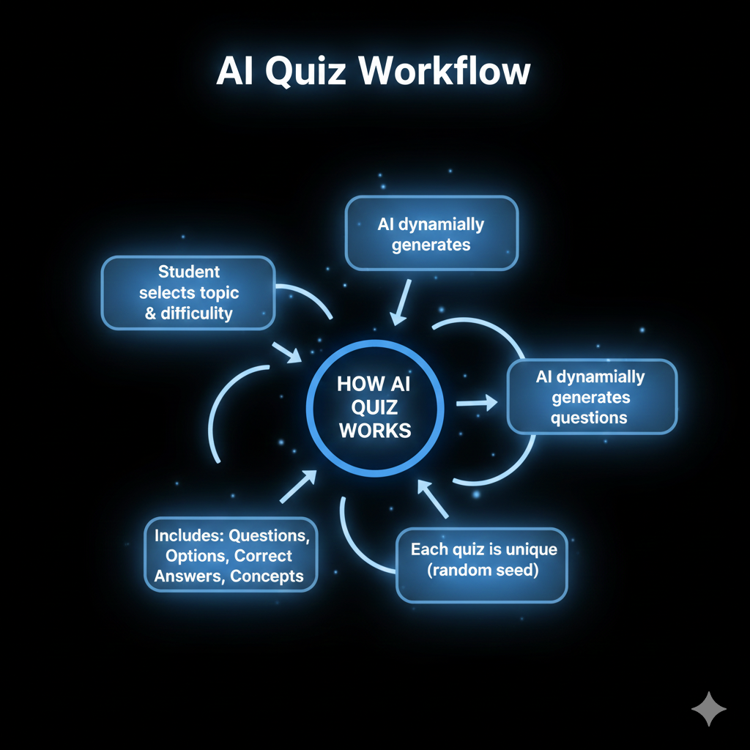
AI Quiz Generation
🤖 How AI Quiz Works
Student selects topic & difficulty
AI dynamically generates questions
Each quiz is unique (random seed)
Includes:
Questions
Options
Correct answers
Concepts

Slide 20
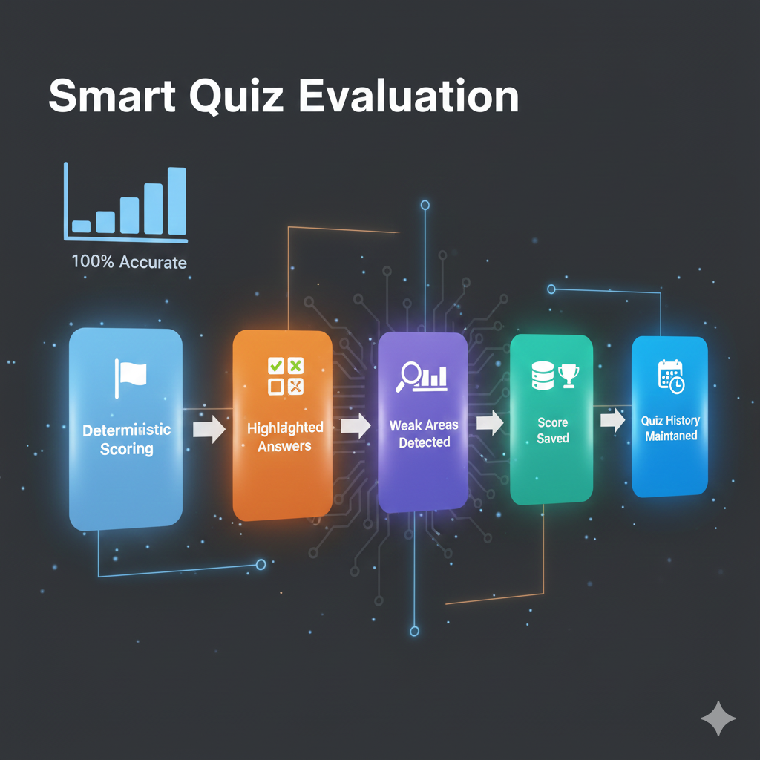
AI Quiz Generation
📊 Smart Quiz Evaluation:
Deterministic scoring (100% accurate)
Correct & wrong answers highlighted
Weak areas automatically detected
Score saved in database
Quiz history maintained

Slide 21
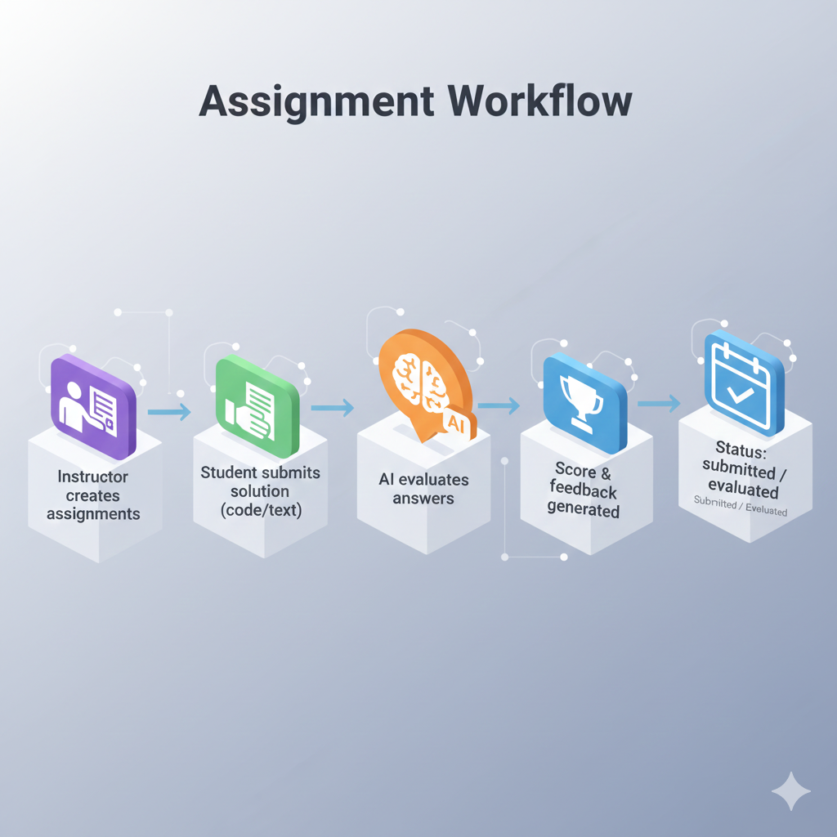
Assignment Module
📘 Assignment Workflow
Instructor creates assignments
Student submits solution (code/text)
AI evaluates answers
Score & feedback generated
Status: submitted / evaluated

Slide 22
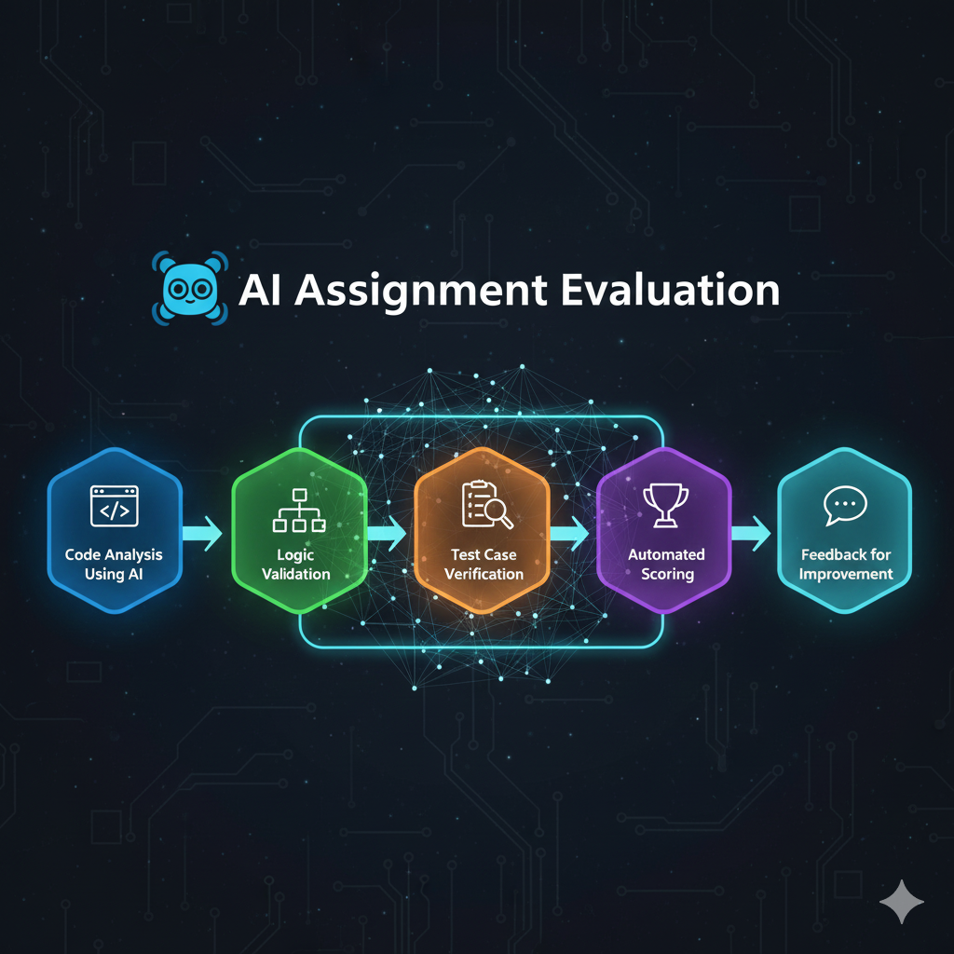
AI Assignment Evaluation
🤖 AI Assignment Evaluation
Code analysis using AI
Logic validation
Test case verification
Automated scoring
Feedback for improvemen

Slide 23
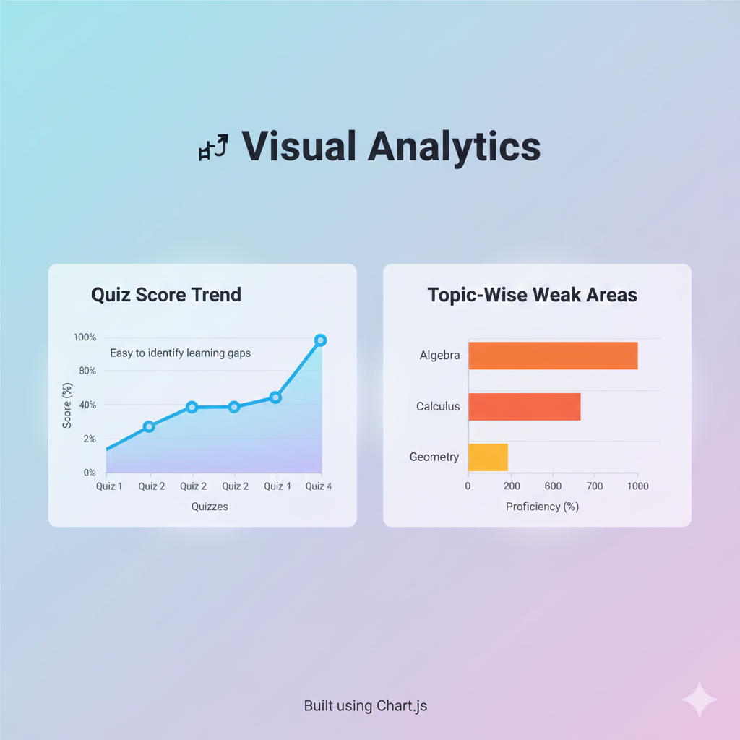
Charts & Graphs
📈 Visual Analytics
Quiz score trend (Line chart)
Topic-wise weak areas (Bar chart)
Easy to identify learning gaps
Built using Chart.js

Slide 24
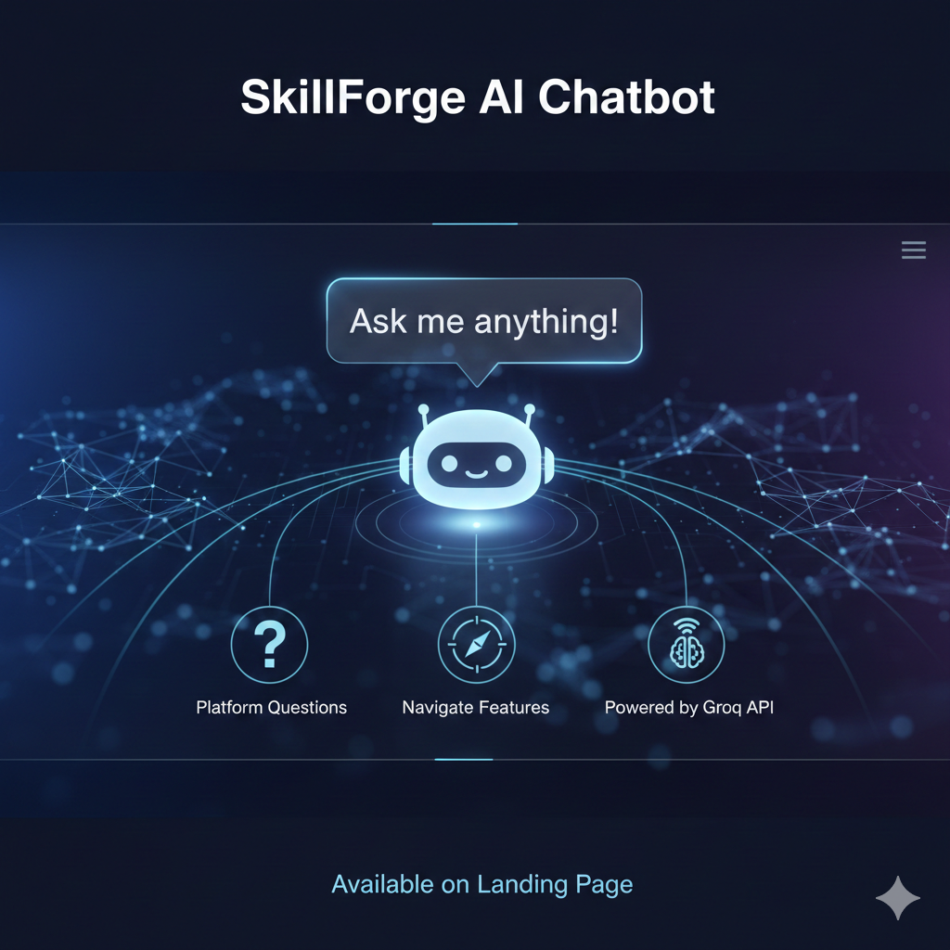
AI Chatbot (Landing Page)
🤖 SkillForge AI Chatbot
Available on landing page
Answers platform-related questions
Helps users navigate features
Powered by free AI API (Groq)

Slide 25
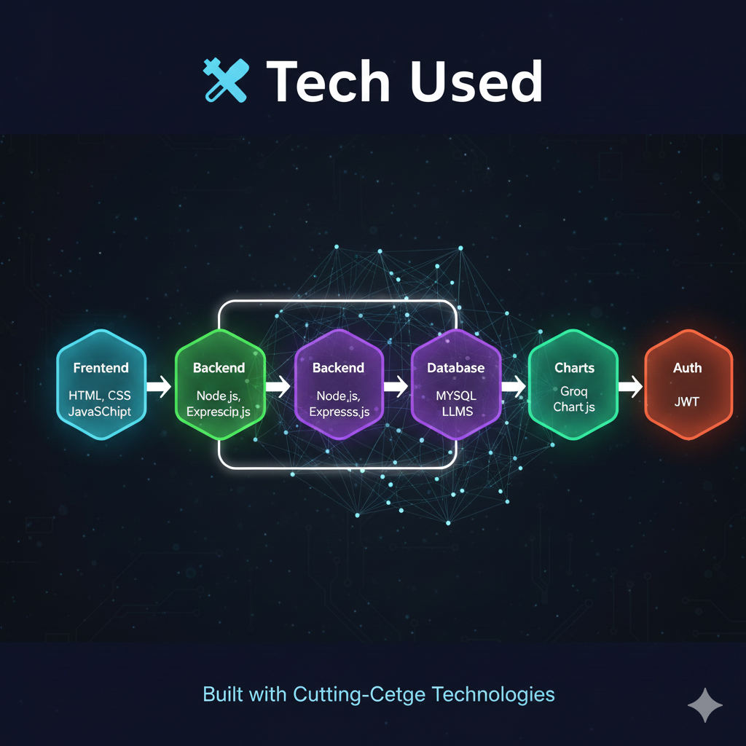
Technology Stack
🛠️ Tech Used
Frontend: HTML, CSS, JavaScript
Backend: Node.js, Express.js
Database: MySQL
AI Models: Groq LLMs
Charts: Chart.js
Auth: JWT

Slide 26
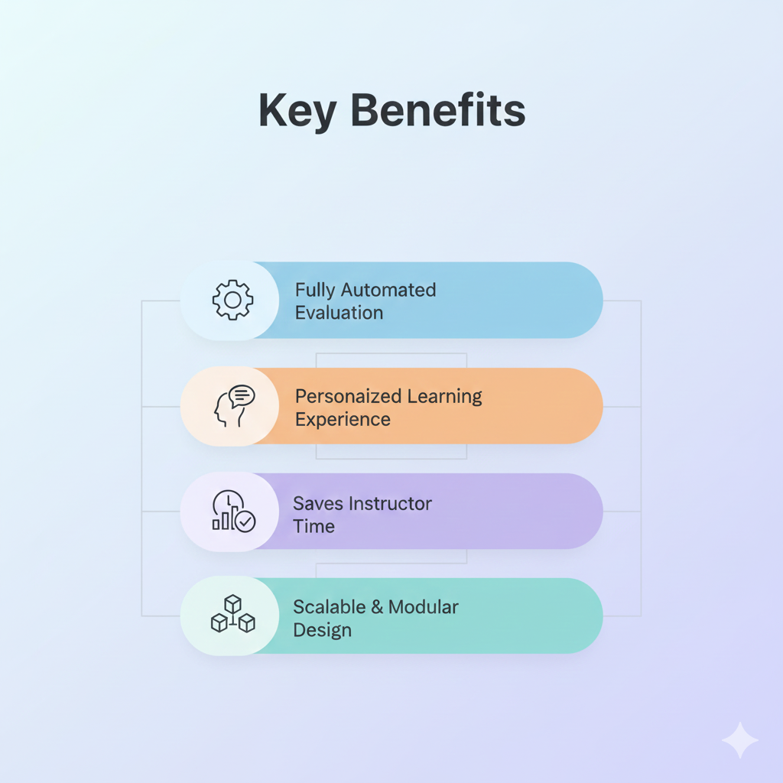
Advantages of SkillForge
Key Benefits
Fully automated evaluation
Personalized learning experience
Saves instructor time
Real-time analytics
Scalable & modular design

Slide 27

Conclusion
🎯 Final Summary
SkillForge is a smart AI-driven learning platform
Enhances both teaching & learning
Combines AI, analytics, and automation
Ready for real-world deployment

Slide 28

THANK YOU

